Slide 1
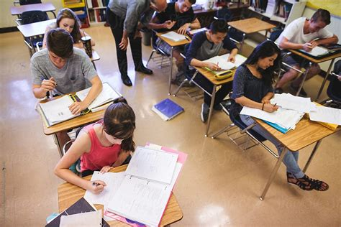
Can demographic characteristics alone be used to predict students’ educational performance across core subjects, such as Maths, Reading, and Writing?
Group 1: Student Performance Analysis
Core Question
By: Group 1 (Abdul, Ace, Bhavita, Igor & Teresa)

Slide 2
Contents:
Conclusions
Main motivation for selecting this dataset
Exploration of the dataset features
Initial review of the scores across Maths, Reading and Writing
Correlation analysis for all features
Model testing with regression using continuous scores:
Predictive modelling illustration (initial focus on banded maths) + regression
Dashboard for further analysis
Recommendations for next steps
Appendix:
Trello Board
Prediction and Actual Plot
Summary of Background Research

Slide 3



Conclusions: Demographic characteristics alone cannot be used to predict students’ educational performance across core subjects, such as Maths, Reading, and Writing
Demographics alone are insufficient to predict academic success, but they may provide some contextual explanation for academic achievement. They are slightly better for predicting writing scores than reading and maths.
Reading prowess is the most powerful single indicator of academic success in Maths and Writing, aligning with educational theory that competency in literacy supports broad academic achievements.
  Reading score is the single best predictor of writing scores. Reading and writing scores are the strongest predictors of Maths performance. Gender adds meaningful value when combined with reading and writing.

Slide 4

Main motivation for selecting this dataset:
Dataset Link: https://www.kaggle.com/datasets/alizabrand/school-performance-analysis
Github Link: https://github.com/M-3rlin/StudentPerformanceAnalysis
Education should be an inclusive system that offers fair and equal opportunities for all, irrespective of demographic background.
This project aims to explore whether specific demographic factors can be used to predict exam results.
The findings could guide government policies on educational strategies and funding allocations, promoting more equitable educational outcomes.

Slide 5


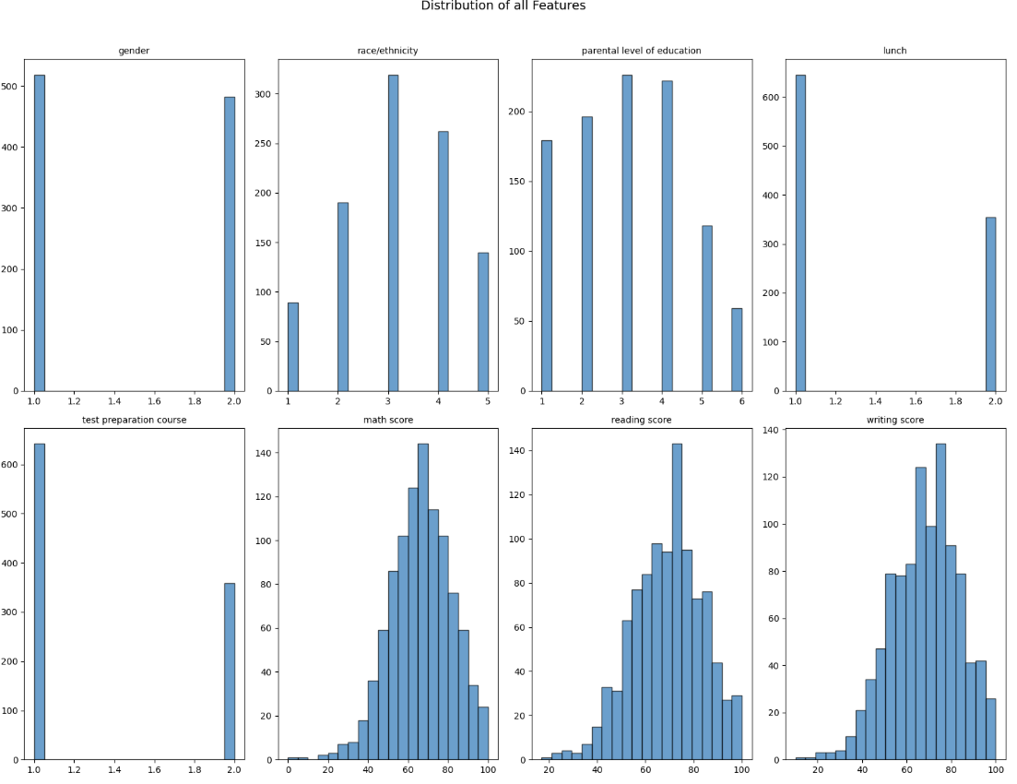
Exploration of the dataset features:
Gender
Female:51.8% Male: 48.2%
Race/Ethnicity
Group A: 9%, Group B: 19%, Group C: 32%; Group D: 26% Group E 14%
Parental level of education
some high school 18% some college 23% associate's degree 22% high school 20% some high school 18% bachelor's degree 13% master's degree 69%
Lunch
Standard 65 % Free/reduced 36%
Test preparation course
None 64% Completed 36%
1000 student exam results for reading, writing and maths were reviewed against 5 demographic characteristics, namely gender, race/ ethnicity, parental level of education, lunch and test preparation score.
Balanced
Skewed
Skewed
Skewed
Skewed

Slide 6
Score distributions are fairly symmetrical and consistent across all 3 subjects (visualisations on next slide):
 | Math Score | Reading Score | Writing Score
Mean | 66 | 69 | 68
Standard deviation | 15 | 14 | 15
Minimum | 0 | 17 | 10
Maximum | 100 | 100 | 100
Median | 66 | 70 | 69
IQR (UQ-LQ) | 20 | 20 | 22
When working through the analysis with or without the outlier it made very little difference to the median and quartile ranges. In this case we decided to include the result in our analysis.
This way the student’s additional results would also be included in the analysis
One person had scored 0 in the maths exam which is assumed to be an outlier. This may have been due to a missed exam, incorrect marking, or the student just had a bad score.

Slide 7
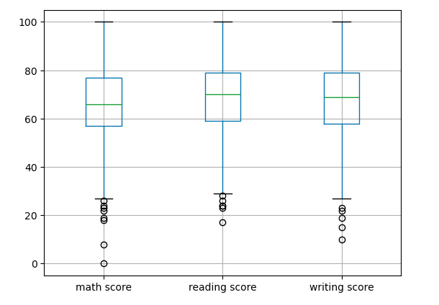
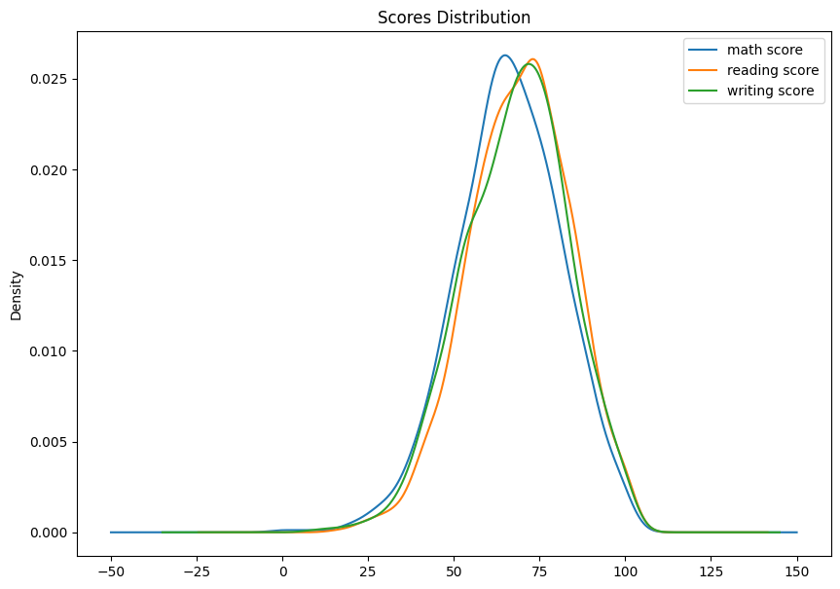
As score distributions are fairly symmetrical and consistent across all 3 subjects, we applied a unified banding to all scores to aid analysis:
The charts below illustrate that the score patterns are consistent across all subjects, which enabled us to apply a unified banding scheme for ease of analysis and reporting:
0 (Low): Scores up to 60
1 (Medium): Scores between 61 and 75
2 (High): Scores of 76 and above

Slide 8
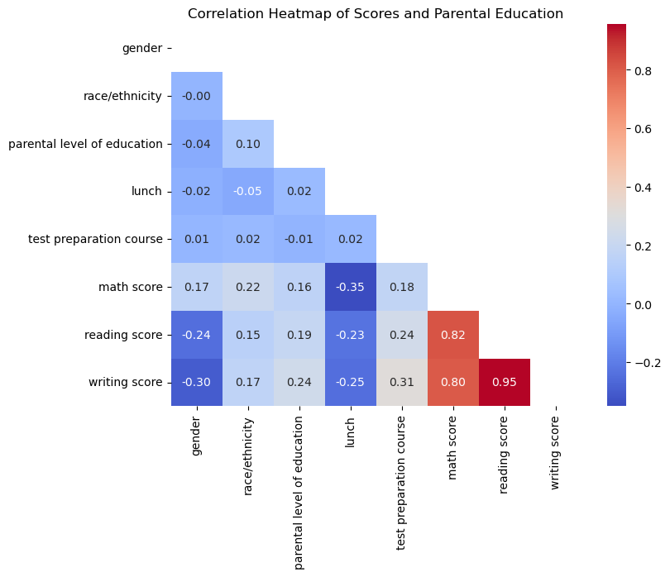
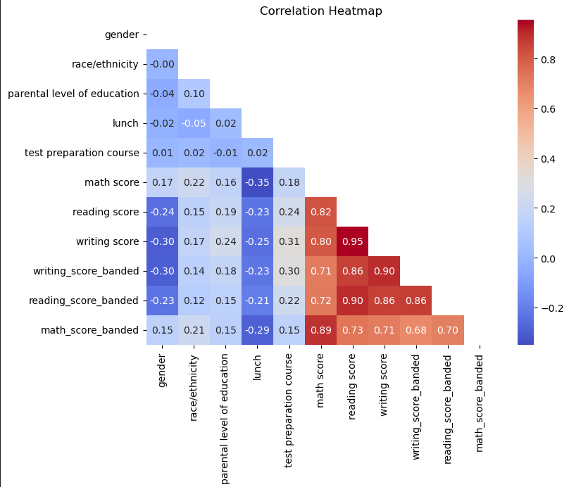
The correlation between exam scores and the five demographic features was weak. In contrast, the three exam scores exhibited a strong correlation with each other.
Summary: Across all three exam subjects, the relationships with demographic features were weak (correlation coefficients < 0.5). In contrast, correlations among the exam scores themselves were strong, with the highest observed between reading and writing (r ≈ 0.95).
Corr with scores unbanded
Corr with scores banded & unbanded

Slide 9
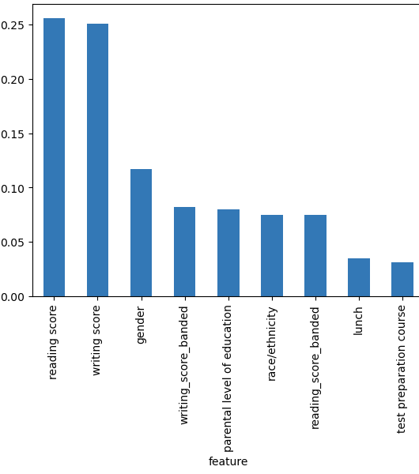
Predictive modelling- Review and analysis:
Methodology and approach
Feature importance (maths banded)
We selected the Random Forest model for its strong accuracy.
Banded scores were analysed with classification, while raw scores were used for regression.
Data was split 80/20 for training and testing. Model performance was evaluated using confusion matrices, feature importance, and error metrics.
Features were refined through elimination and iteration, and results were plotted for comparison.
Example graph: maths banded prediction shows top 3 features are reading score, writing score and gender

Slide 10
Model testing with banded maths score as an illustration of the predictive model:
Banding scheme was:
0 (Low): Scores up to 60
1 (Medium): Scores between 61 and 75
2 (High): Scores of 76 and above

Slide 11
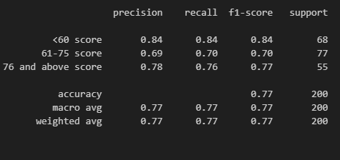
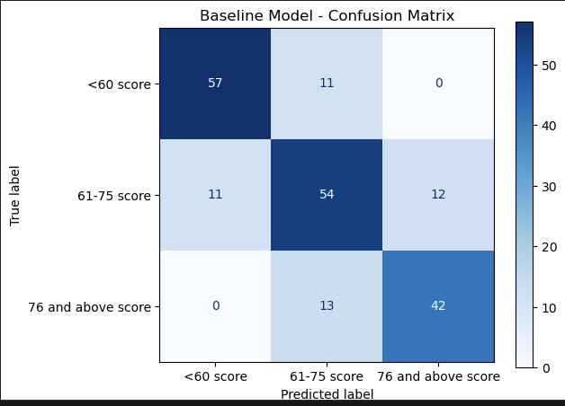
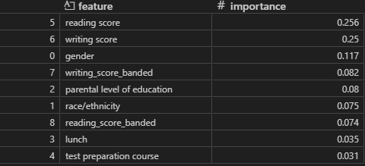
Illustration of a Confusion Matrix with banded Math scores:
Accuracy = 76.5%

Slide 12
Predictive model (banded maths scores) illustrate that academic scores drive predictive power more than demographics:
Summary:
Demographics alone are weak predictors (accuracy: 0.36).
Using all features gives the best predictive results, but a small subset (reading, writing, gender) gets close (accuracy: 0.755)
Reading scores are the strongest individual predictors of Math's performance (accuracy: 0.625)
Continuous reading & writing scores are stronger predictors than banded scores.
Banded Maths | Model Accuracy
All 9 features (5 x demographics, continuous & banded reading and writing scores) | 0.755
7 features (excluding banded reading and writing scores) | 0.73
7 features (excluding continuous reading and writing scores) | 0.655
Top feature (reading score) | 0.625
Top 3 features (reading, writing and gender scores) | 0.745
Top 2 features (reading and writing scores) | 0.585
5 demographic features (gender, parental level of education, race/ethnicity, lunch, test preparation course) | 0.36
Notes:
All 9 features → 0.755 This is your baseline. Using everything gives the highest accuracy, as expected.
7 features (excluding banded reading/writing) → 0.73 Slight drop compared to all features. Makes sense: reading/writing banded scores carry predictive signal, so removing them reduces accuracy.
7 features (excluding continuous reading/writing) → 0.655 Much bigger drop. Continuous reading/writing scores are stronger predictors than banded ones, so excluding them hurts more.
Top feature (reading score) → 0.625 Reading alone is fairly predictive, but not enough to capture full variance. This aligns with intuition: maths and reading are correlated.
Top 2 features (reading + writing) → 0.585 Interesting: accuracy drops compared to reading alone. That suggests writing score may be collinear or even noisy relative to maths, reducing model performance when paired with reading.
Top 3 features (reading + writing + gender) → 0.745 Big jump! Gender adds useful discriminatory signal, and perhaps the model leverages interaction effects. This result is consistent with demographic features sometimes boosting accuracy when combined with academic scores.
5 demographic features only → 0.36 Very low, which makes sense. Demographics alone are weak predictors of maths achievement compared to direct performance measures.

Slide 13
Although demographics alone offer limited predictive power, there is slightly better performance for predicting writing scores than math scores:
Banded Writing Scores | Accuracy
5 demographic features (gender, parental level of education, race/ethnicity, lunch, test preparation course) | 0.425
Banded Reading Scores | Accuracy
5 demographic features (gender, parental level of education, race/ethnicity, lunch, test preparation course) | 0.4
Banded Maths Scores | Accuracy
5 demographic features (gender, parental level of education, race/ethnicity, lunch, test preparation course) | 0.36

Slide 14
Model testing with regression using continuous scores

Slide 15
The reading score is the single best predictor of the writing score. Demographics provide marginal context
Predicting Writing Score
5 demographic features (gender, parental level of education, race/ethnicity, lunch, test preparation course) + reading score | R2 score: 0.8969871 Mean Absolute Error: 3.9122735 Root Mean Squared Error: 4.982755
5 demographic features (gender, parental level of education, race/ethnicity, lunch, test preparation course | R2 score: 0.1017208 Mean Absolute Error: 11.20518199469 Root Mean Squared Error: 14.713956534
Predicting Writing Score
5 demographic features (gender, parental level of education, race/ethnicity, lunch, test preparation course) + math score | R2 score: 0.8465262365 Mean Absolute Error: 4.96230869 Root Mean Squared Error: 6.081922575958346
5 demographic features (gender, parental level of education, race/ethnicity, lunch, test preparation course | R2 score:0.101728768 Mean Absolute Error: 11.205181994694376 Root Mean Squared Error: 14.713956537767022

Slide 16
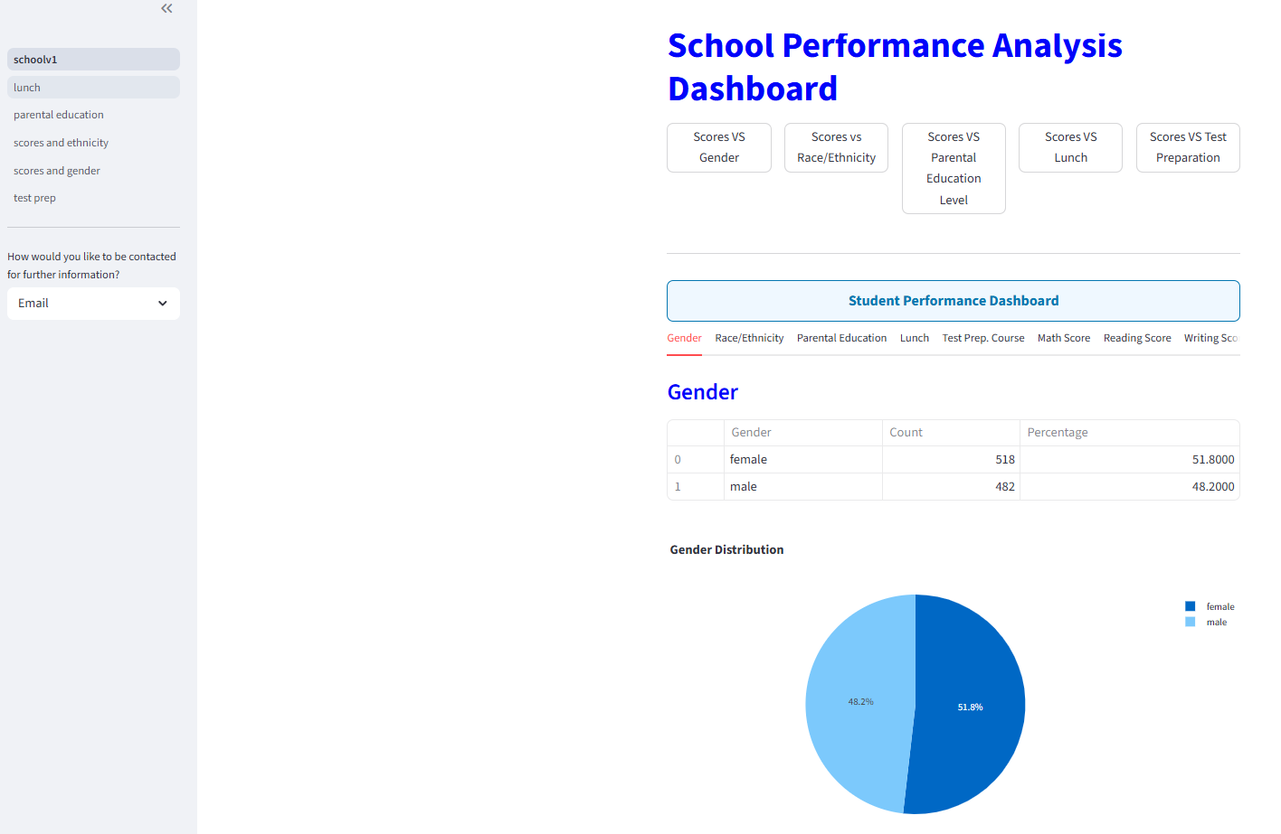
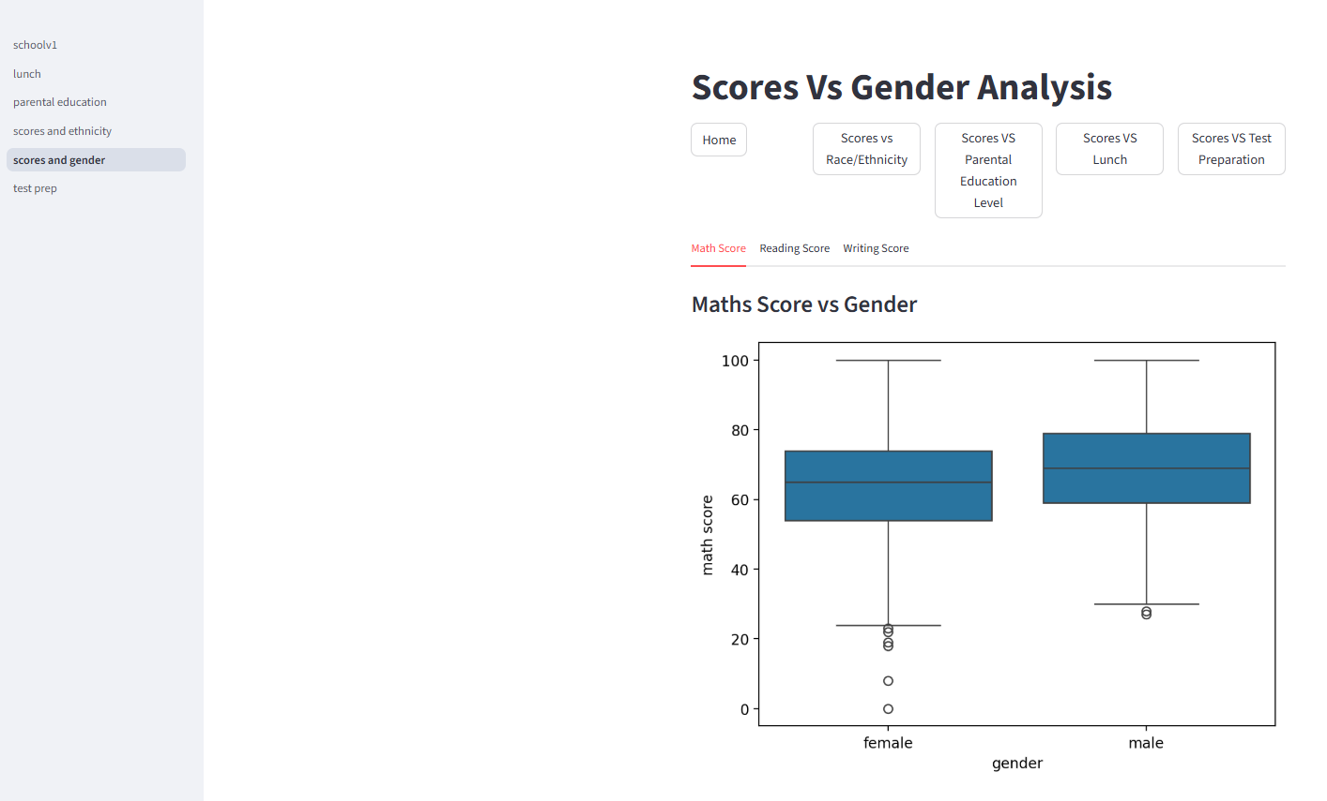
Dashboard for further analysis:

Slide 17
Recommendations for next steps for improving the model’s predictability:
Improving data quality:
  more data samples
  real data vs synthetic data
  additional feature engineering
Cross-validation techniques:
  k-fold
  hyperparameter tuning
Model selection:
  review alternative machine learning models and compare their performance
Feature selection:
  Reduce dimensionality e.g. Principal Component Analysis (PCA) or Recursive Feature Elimination (RFE)
Data Preprocessing:
  Standardisation/Normalisation – scaling features

Slide 18
Appendix

Slide 19

Trello board:
The team divided up and organised the tasks under the following categories:
Define task and motivation
Set up documents (Jupyter notebook, PowerPoint, GitHub and etc.)
Data review and cleaning
EDA
Feature Engineering
Predictive modelling
Presentation

Slide 20
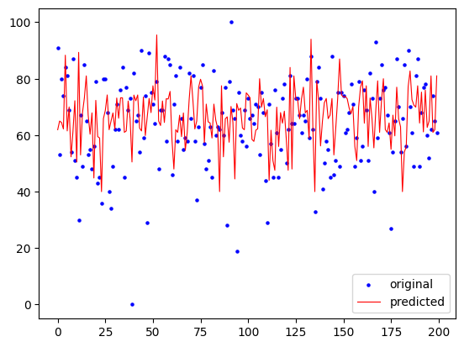
Prediction and Actual Plot:
https://www.kaggle.com/datasets/alizabrand/school-performance-analysis
This plot compares original writing scores with model predictions, showing how closely the regression model tracks the true values when academic features are included.

Slide 21
Summary of background research:
https://www.kaggle.com/datasets/alizabrand/school-performance-analysis
Higher parental education and socioeconomic status (SES) are consistently associated with stronger academic performance due to greater access to support and resources at home. Ethnic minority students—particularly Black and Latino learners—often experience additional barriers, largely influenced by SES, school quality, and resource availability rather than ethnicity alone.
Gender-related performance differences exist but are generally smaller and subject-specific compared to the much stronger effects of SES and parental education.
Overall, these demographic factors help shape expectations around student achievement patterns in U.S. education research.

